Slide 1


Neural Network project
Bidirectional Generative Adversarial Networks
Fabrizio Casadei Edoardo Papa

Slide 2



The origin: GAN
Key points:
Generator
Discriminator
Adversarial relationship
The BiGAN is a direct variation of the classical Generative Adversarial Network

Slide 3
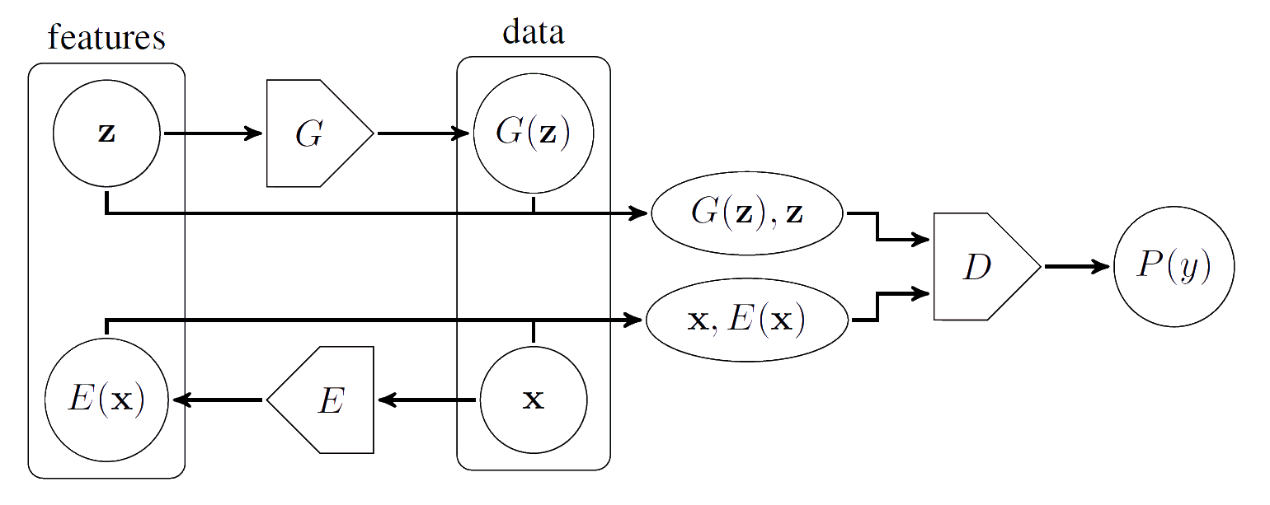
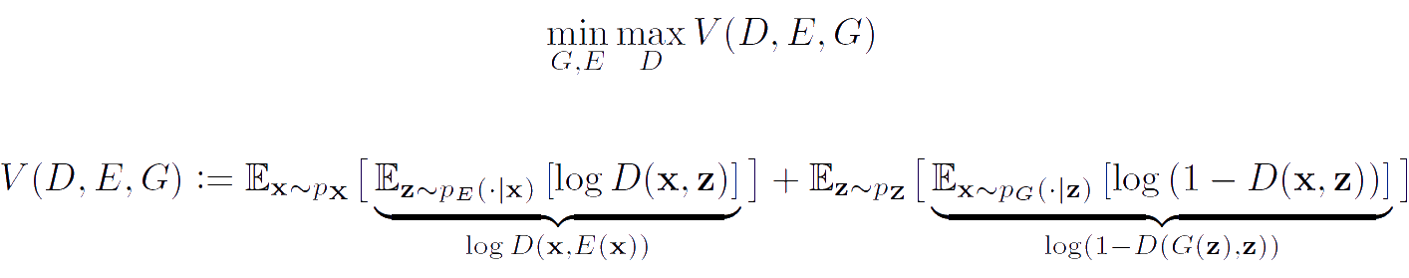
The BIGANs framework
Addition of the Encoder to map data to its intrinsic representation
D discriminates both (x,E(x)) and (z,G(z))
Min-Max loss function

Slide 4

Networks Structure
 | G | E
Layers | 6 | 7
Type | 2D Transpose convolution and batch normalization | 2D convolution and batch normalization
Activation function output | Hyperbolic Tangent | Linear
Activation function hidden layer | Relu | Leaky Relu

Slide 5
Networks Structure
 | D(x) | D(z) | Joint Inference
Layers | 10 | 4 | 5
Type | 2D convolution, Batch normalization and 2D Dropout | 2D convolution and 2D Dropout | 2D convolution and Dropout
Activation function output | Leaky Relu | Leaky Relu | Sigmoid
Activation function hidden layer | Leaky Relu | Leaky Relu | Leaky Relu

Slide 6
Learning process
The Discriminator:
Reset of the D gradients
Compute G(z) from a random latent variable
Take image x from the mini-batch and perform E(x)
Generate noise ε and estimate
D(x+ε, E(x)) and D(G(z) + ε, z)
Determine the loss for D
Backpropagation and update of the network
The Generator and Encoder:
Reset the G and E gradients
Generate noise ε and use the values already carried out to estimate
D(x+ε, E(x)) and D(G(z) + ε, z)
Determine the loss for G and E
Backpropagation and update the networks G and E

Slide 7
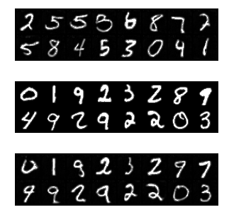
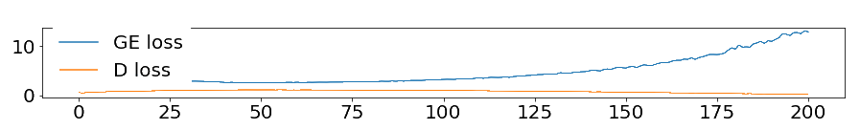
Results: MNIST
Noise enabled | Reparametrization Enabled | 1-NN Accuracy (%)
Yes | Yes | 75%
No | Yes | 50%
Yes | No | 53%
G(z)
x
G(E(x))

Slide 8
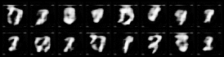

Slide 9
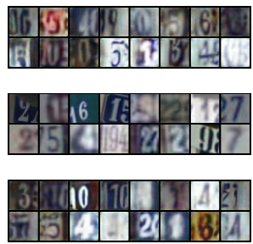
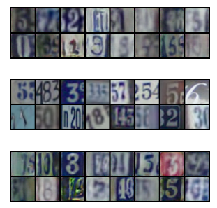
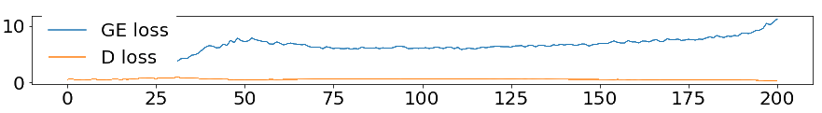
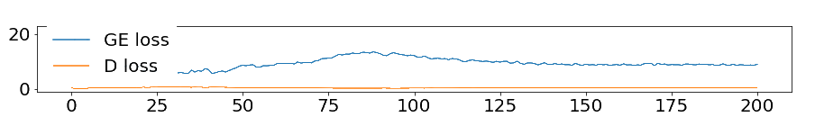
Results: SVHN
Noise added
No noise
G(z)
x
G(E(x))
G(z)
x
G(E(x))

Slide 10
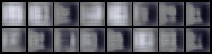

Slide 11
Future implementations
Variable noise over training
Use of the trick "Train with labels"
Introduction of Regularization methods (Early stopping, Data augmentation, etc.)
Improve the project to achieve good results on more difficult datasets (i.e. Celab A)

